Slide 1
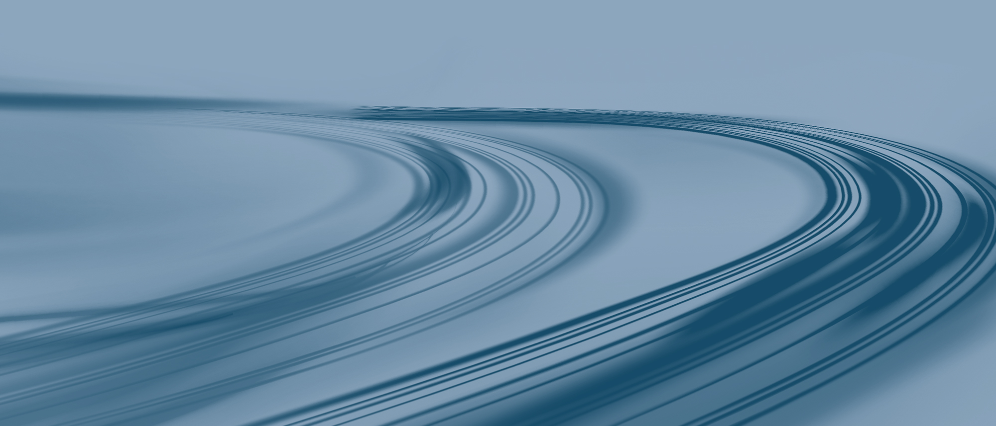
How sound is created by instruments
Alexander Luce

Slide 2

Sound and motion
Sound is a pressure wave that propagates in air
Excitation of the pressure wave by moving objects
An oscillatory movement creates an oscillatory pressure wave
https://youtu.be/px3oVGXr4mo?t=9

Slide 3
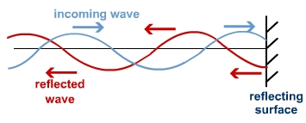
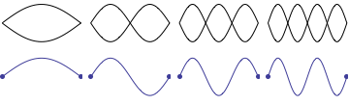
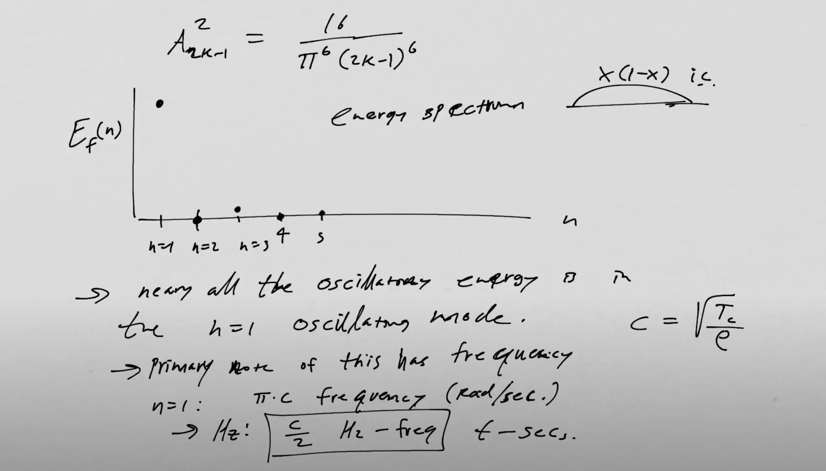
Spatial Modes of instruments
In physics a standing wave, also known as a stationary wave, is a wave that oscillates in time but whose peak amplitude profile does not move in space
A spatial mode/standing wave is created when a wave is reflected at a boundary in such a way that the reflected waves interfere constructively
Frequency of the oscillation defined by material and geometry
An instrument distributes the energy differently on the available modes
https://s-cool.co.uk/a-level/physics/progressive-waves/revise-it/standing-waves
https://www.acs.psu.edu/drussell/Demos/Pluck-Fourier/Pluck-Fourier.html
https://www.youtube.com/watch?v=37DxabEb4Ew&ab_channel=WilliamNesse

Slide 4
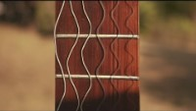
Lets get rid of a myth
This is not how strings move
The phenomenon here is a camera artifact, the sc. rolling shutter effect
The artifact occurs when recording movement which is much faster than the camera shutter speed
(60Hz normal camera vs 440Hz A4)
https://www.youtube.com/watch?v=XOCGb5ZGEV8&ab_channel=RuyMascar%C3%BAa

Slide 5
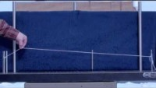
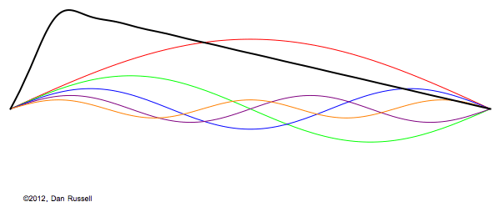
Excitation of spatial modes on a guitar string
Frequency components which are not in resonance will decay quickly
Only the harmonicas oscillate longer
The movement through air excites a pressure wave at the same frequency
https://www.acs.psu.edu/drussell/Demos/Pluck-Fourier/Pluck-Fourier.html
https://www.youtube.com/watch?v=_X72on6CSL0&ab_channel=DanRussell

Slide 6
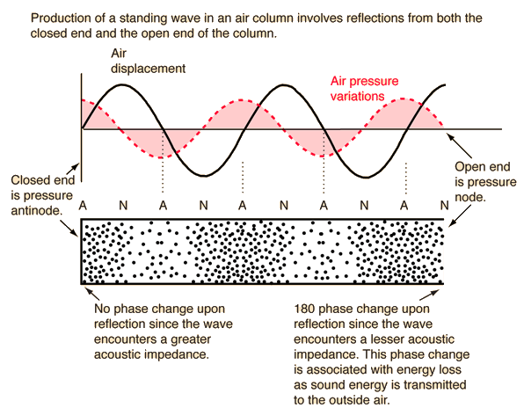
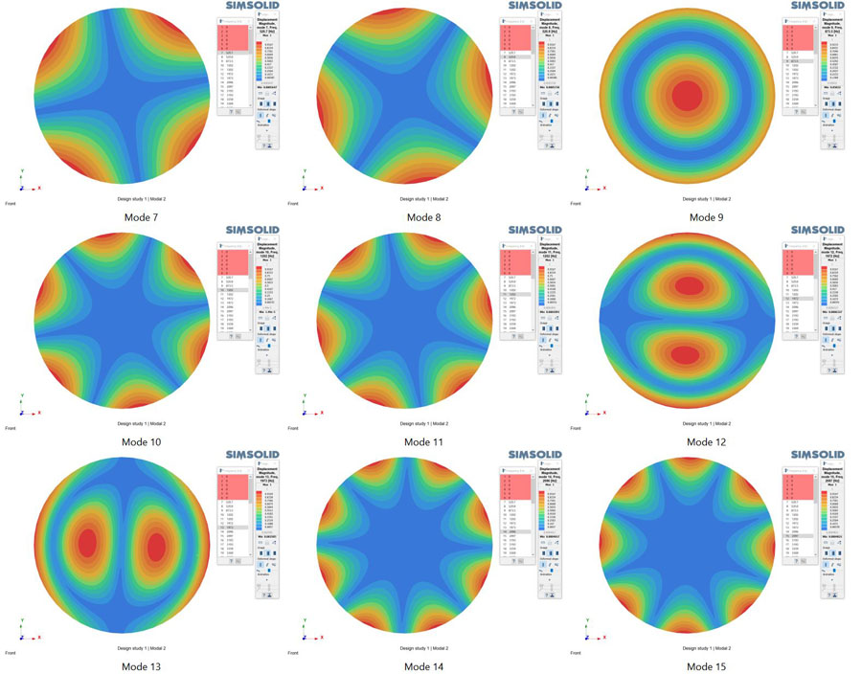
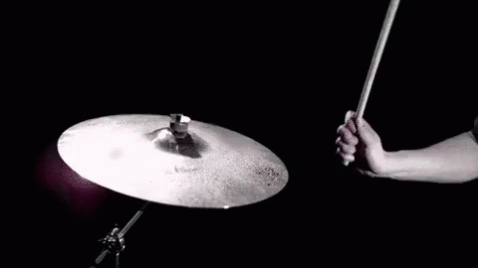
The principle remains the same for other instruments
Flute: traveling pressure wave
Drums: Oscillating 2D surface
…
http://hyperphysics.phy-astr.gsu.edu/hbase/Sound/reflec.html
Modes of a cymbal
https://tenor.com/view/slow-motion-drums-gif-5470820
FEM Modes of a circular object
https://www.altair.com/newsroom/articles/High-frequency-modal-analysis-in-Altair-SimSolid

Slide 7
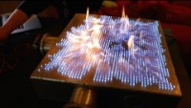
Standing wave in a 2D Rubens Tube
Most gas leaves the table at maximum amplitude of the pressure wave
The patterns emerge due to the superposition of the modes of the frequncy components of the music

